Slide 1

Bama Racing Innovation
Charles Hartsell & John Mitchell

Slide 2
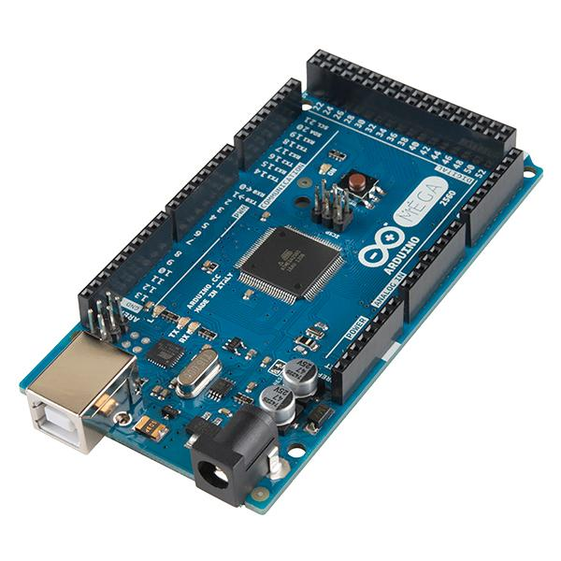
Data Acquisition System
Arduino MEGA 2560
Data Gathered:
Drive Axle RPM
Engine RPM
Vehicle Acceleration
CVT Temperature

Slide 3
Data Logging
Serial Interface with in-vehicle micro SD card
Logs data from sensors:
Engine RPM
Axle RPM
Acceleration
CVT ratio determined using Engine & Axle RPM

Slide 4
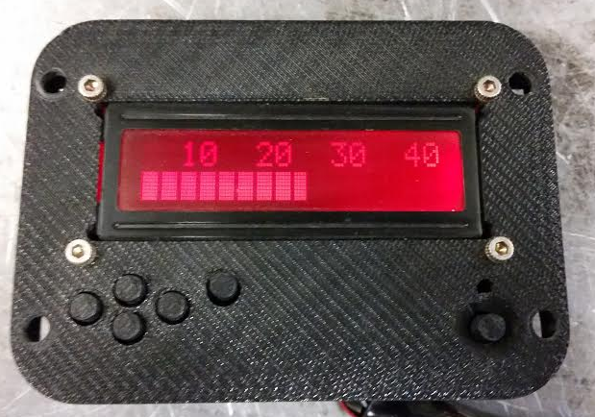
Driver Interface
16x2 LCD Display:
Current Speed
Hour meter
Odometer
Tachometer

Slide 5
Engine RPM Sensor
Capacitive pickup on spark plug wire
Noisy input
74221 monostable multivibrator (aka “one-shot”) used to provide clean rectangular pulse to Arduino

Slide 6
Axle RPM Sensor
GM camshaft position sensor (inductive pickup)
Op-Amp circuit to boost the signal to 5V logic level

Slide 7
3-Axis Accelerometer
I2C interface with microcontroller through 3.3 to 5V Logic Leveler
Selectable range of ±2g/ ±4g/ ±8g
Secondary Speed measurement
Vehicle Orientation

Slide 8
Power Consumption
Typical Current Draw:
Brake/Reverse Light: 100 mA each
Reverse Alarm: 70 mA
Arduino: 25 mA under load
Sensors/Screen: 20 mA typical
Significant power consumption by Data Acquisition System
5 Ah battery chosen for long battery life (approximately 55 hours)

Slide 9
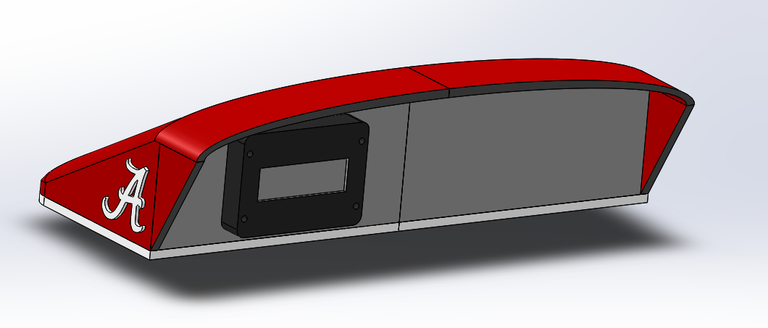
Dashboard
Low-Profile for Driver Visibility
3D Printed for ease of manufacture and light weight
Total Weight (inc. DAS): ~4 lbs

Slide 10
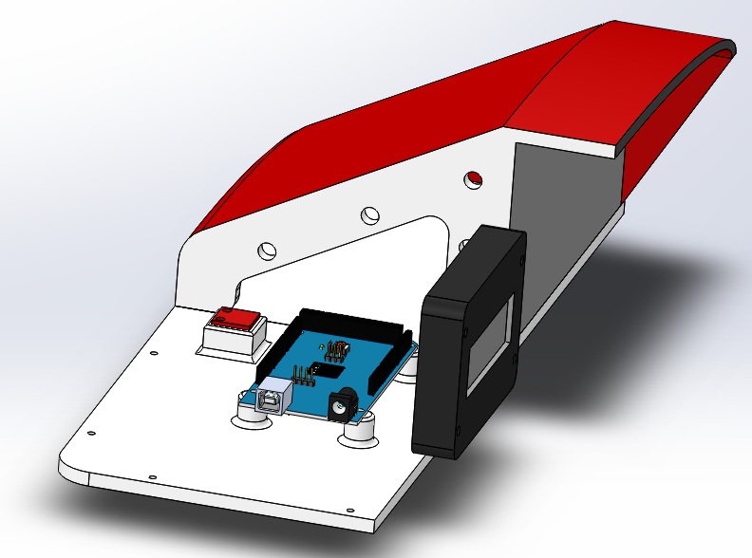

Slide 11
Cost Report
Arduino MEGA: 45.95
Display: 8.20
Accelerometer: 9.95
Position Sensor: 25.28
Temp Sensor: 1.50
Misc: ~20.00
Total: 110.88
Entire Electrical Cost: 391.78

